Slide 1
Software Requirements Elicitation
Lecturer: Ngo Huy Bien
Software Engineering Department
Faculty of Information Technology
VNUHCM - University of Science
Ho Chi Minh City, Vietnam
nhbien@fit.hcmus.edu.vn

Slide 2

Objectives
To elicit requirements.

Slide 3

Contents
Interviewing the Stakeholders
Questionnaires
Group Meetings, Focus Groups
Workshops
Personas
Brainstorming
Document Archeology
Apprenticing
Observing Structures and Patterns
User Interface Analysis
System Interface Analysis
Reverse Engineering

Slide 4

References
George Koelsch (2023). Hardware and Software Projects Troubleshooting - How Effective Requirements Writing Can Save the Day. Apress.
Suzanne Robertson and James Robertson (2012). Mastering the Requirements Process. Addison Wesley Professional.
Dean Leffingwell (2011). Agile Software Requirements. Lean Requirements Practices for Teams, Programs, and the Enterprise. Addison-Wesley Professional.
Karl Wiegers and Joy Beatty (2013). Software Requirements. Microsoft Press.

Slide 5
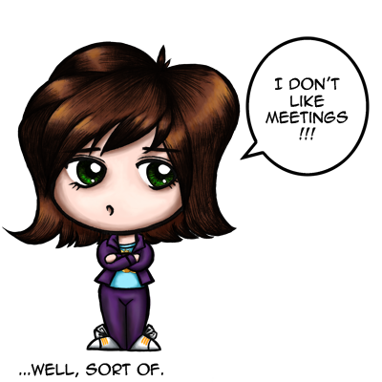

Software Requirements Elicitation

Slide 6
Requirements Sources [1]
Think of them as people, paper, and projects:
Stakeholders
Documents
System in operation

Slide 7


Slide 8
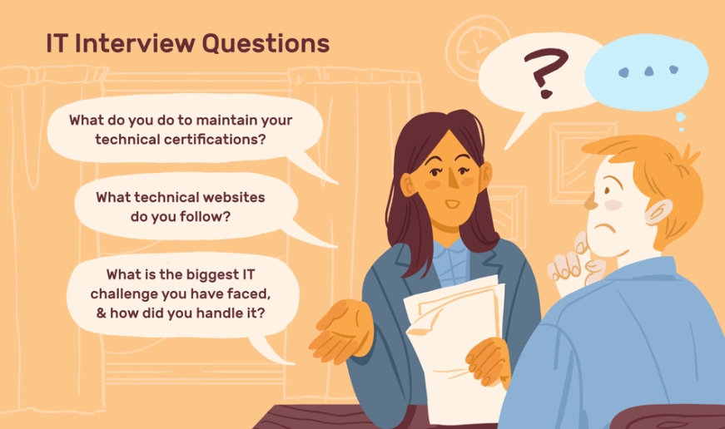
Interviewing the Stakeholders [2]
Prepare background information (company, preliminary problems, needs, opportunities, goals, key stakeholders).
Prepare interview questions.
Set the interview in context. This step is necessary to avoid having your stakeholders talk about something irrelevant to your purpose.
Limit the duration of the interview to the time stated in the agenda. We find that interviews running for more than an hour (90 minutes tops) tend to lose focus.

Slide 9

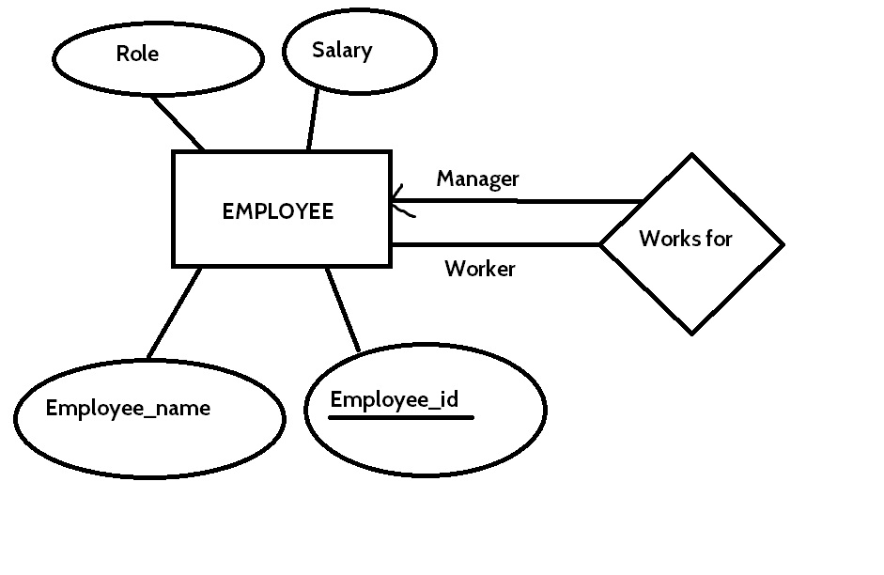
Conducting the Interview
Ask a question, listen to the answer, draw models and encourage the user to change them.
Plenty of models (e.g., data flow diagrams, activity diagrams, sequence diagrams) are available to help you communicate your understanding of a process.
You can also construct data models for information, and mind maps to link different subjects.
Record the stakeholders’ terminology.

Slide 10

Keep Samples or Copies of Artifacts
Artifacts are the things the stakeholders use in their daily work.
They can be real things: documents, computers, meters, spreadsheets, machines, pieces of software.
They can also be conceptual things: status, contracts, schedules, orders.

Slide 11

Guidelines – 1
Comparison: When you hear the word "better," ask, "Compared to what?“
Generalization: When you hear the words "can't" or "must," then ask: What prevents you? What would happen if you did not?
Universal Quantifiers: When you hear "never" or "always," it triggers other questions: Is it really never or does it happen sometimes? Is it really always or are there some exceptions?

Slide 12
Guidelines – 2
Nominalization: In nominalization, a verb that describes an ongoing process is turned into a noun for example, "Processing renewals over the Internet is better." But what does the speaker mean by "processing"? What activities are implied by the use of that word in this context?
Judgment: Who says that it is better? What is the authority?

Slide 13
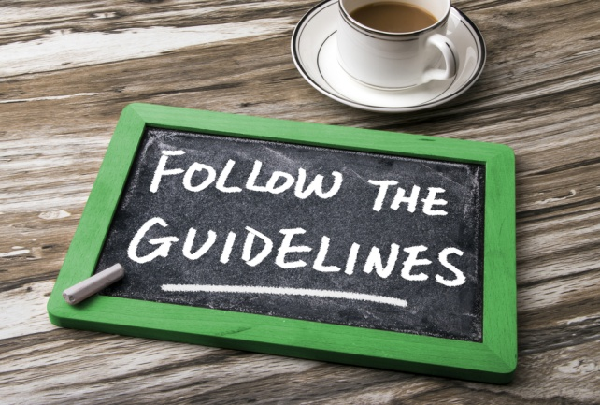
The Interview Template (I) [3]
Part I: Establishing the Customer or User Profile
Name:
Company:
Industry:
Job title:
(The above information can typically be
entered in advance.)
What are your key responsibilities?
What outputs do you produce?
For whom?
How is success measured?
Which problems interfere with your success?
What, if any, trends make your job easier or more difficult?

Slide 14
The Interview Template (II)
Part II: Assessing the Problem
For which [application type] problems do you lack good solutions?
What are they? (Hint: Keep asking, “Anything else?”)
For each problem, ask the following questions.
Why does this problem exist?
How do you solve it now?
How would you like to solve it?

Slide 15
The Interview Template (III)
Part V: Analyzing the Customer’s Problem
(Validate or invalidate assumptions.)
(If not yet addressed.) Which, if any, problems are associated with the following? (List any needs or additional problems you think should concern the customer or user.)
…
For each suggested problem, ask the
following questions.
Is this a real problem?
What are the reasons for this problem?
How do you currently solve the problem?
How would you like to solve the problem?
How would you rank solving these problems in comparison to others you’ve mentioned?

Slide 16

Questionnaires [4]
Questionnaires are a way to survey large groups of users to understand their needs.
They are inexpensive, making them a logical choice for eliciting information from large user populations, and they can be administered easily across geographical boundaries.
Preparing well-written questions is the biggest challenge with questionnaires.
Provide answer options that cover the full set of possible responses.
Make answer choices both mutually exclusive
Don’t phrase a question in a way that implies a “correct” answer.
Don’t ask too many questions or people won’t respond.

Slide 17

Group Meetings, Focus Groups [4]
A focus group is a representative group of users who convene in a facilitated elicitation activity to generate input and ideas on a product’s functional and quality requirements.
Focus groups are useful for exploring users’ attitudes, impressions, preferences, and needs.
They are particularly valuable if you are developing commercial products and don’t have ready access to end users within your company.
Only real users
Generating ideas

Slide 18

Workshops
Workshop: a structured meeting in which a carefully selected group of stakeholders and content experts work together to define, create, refine, and reach closure on deliverables (such as models and documents) that represent user requirements.
Note taking, time keeping, scope management, ground rule management, and making sure everyone is heard.
Refer to the business requirements to confirm whether proposed user requirements lie within the current project scope.
Real users and
other stakeholder
Consensual conclusion

Slide 19
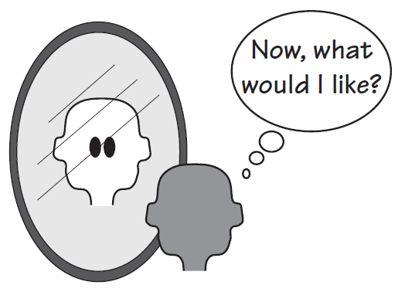
Personas [2]
Personas are useful when real users are not available or are too numerous for you to interview all of them.
The persona is a virtual character that substitutes for the human users.
We strongly suggest using a persona when you do not have access to the real users or customers.

Slide 20
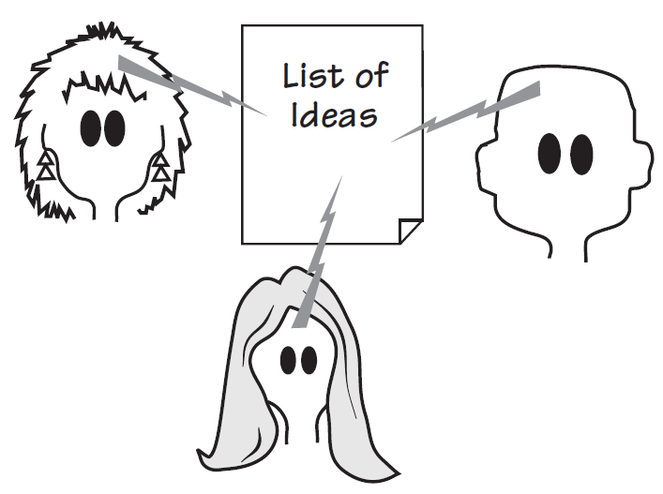
Brainstorming
A brainstorming session is a gathering of interested people whose task is to generate new ideas for the product.
For the moment, suspend judgment, evaluation, criticism, and, most importantly, debate. Simply record requirements as they are generated.
If you get stuck, seed the session with a word pulled randomly from a dictionary, and ask participants to make word associations that have some bearing on the product.

Slide 22

Document Archeology [2]
Document archeology is a technique of searching through existing reports and files for underlying requirements.
It is best used when you have some existing or legacy system, and plan on modifying or renewing it.
In document archeology, you start by collecting samples of all documents, reports, forms, files, and so on.
Gather anything that is used to record or send information, including regular telephone calls.
User manuals are rich sources of material they describe a way to do work.

Slide 23

Other Documents
Suggestions, RFCs, and problem reports
Request for Proposals (RFPs)

Slide 25
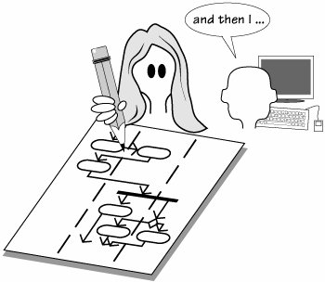
Apprenticing [2]
"Nobody can talk better about what they do and why they do it than they can while in the middle of doing it."
-- Beyer and Holtzblatt
The requirements analyst learns the work while sitting at the user's desk. Sometimes models of the work are built while learning it.

Slide 26
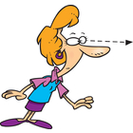
Observing Structures and Patterns
By seeing the users at work over a period of time, you can determine an abstract structure or a pattern to the work.
The structure is a framework for the user to do his task for the normal cases, although it also supports improvisation to handle the exceptions.
Once you have observed the structure, look for patterns. Does this structure match, or almost match, another structure?

Slide 27
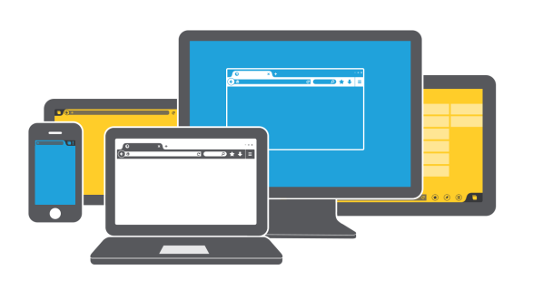
User Interface Analysis [4]
User interface (UI) analysis is an independent elicitation technique in which you study existing systems to discover user and functional requirements.
It’s best to interact with the existing systems directly, but if necessary you can use screen shots.
User manuals for purchased packaged-software implementations often contain screen shots that will work fine as a starting point.
If there is no existing system, you might be able to look at user interfaces of similar products.

Slide 28
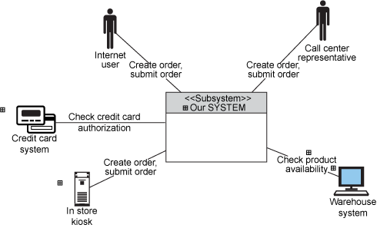
System Interface Analysis
Interface analysis is an independent elicitation technique that entails examining the systems to which your system connects.
System interface analysis reveals functional requirements regarding the exchange of data and services between systems.

Slide 29
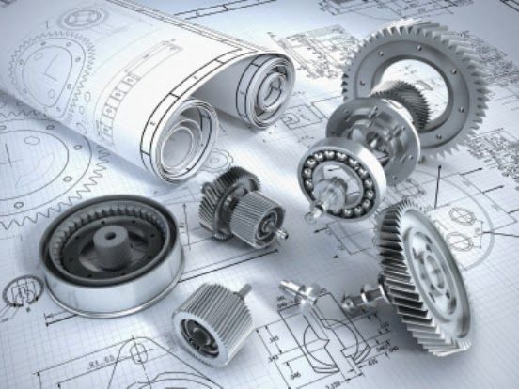
Reverse Engineering [1]
Figuring out what the system does by taking it apart.

Slide 31

Types of Requirements
Which types of requirements can be discovered using the elicitation techniques?
Business requirements.
User requirements.
Software requirements.

Slide 32
When Are You Done?
How do you know when you’re done?
The users can’t think of any more use cases or user stories.
Users propose new scenarios, but they don’t lead to any new functional requirements.
Despite your best efforts to discover all the requirements, you won’t, so expect to make changes as construction proceeds.
your goal is to accumulate a shared understanding of requirements that is good enough to let construction of the next release or increment proceed at an acceptable level of risk.

Slide 33

Thank You & See You Again

